Slide 1

.NET Maui
Data Binding and MVVM
Data binding and MVVM - .NET MAUI | Microsoft Learn

Slide 2
Content
Data binding concept
Model – View Model – View Concept (MVVM)
Show MVVM implementation on the Monkeys Exercise Solution
Self Learning + Exercise
Picker
TableView

Slide 3
Databinding Concept
One Way
Source Object
Target Object
Two Way
One Way To Source
One Time

Slide 4
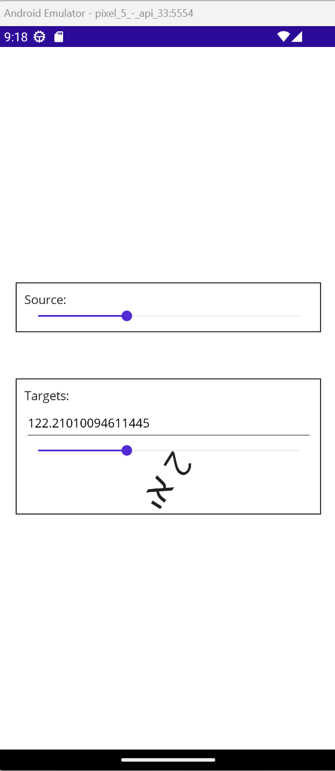
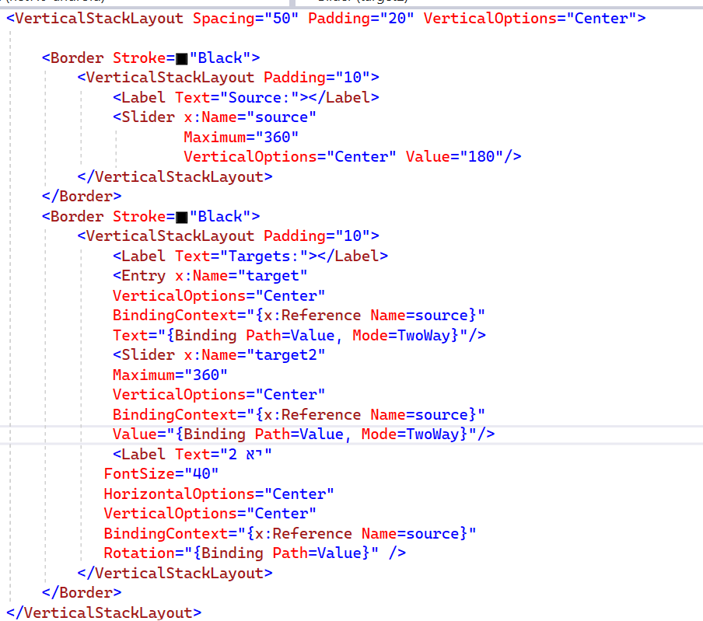

Slide 5
Databinding Concept
INotifyPropertyChanged
Property Changed Event
INotifyPropertyChanged
BindableObject
Binding Context
Source Object
Target Object

Slide 6
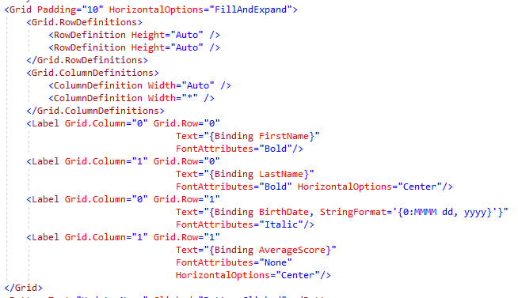
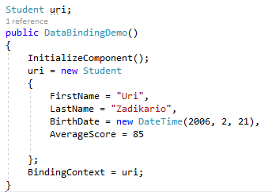
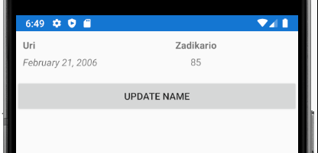
Data Binding Using home made classes
Data binding connects UI objects with Data model objects and ensures one reflects the other.
The student object uri includes properties. Instead of setting each Label text with the relevant property value, we can set the objects as the Page BindingContext and set in the XAML for each Label the proper property value to bind!

Slide 7

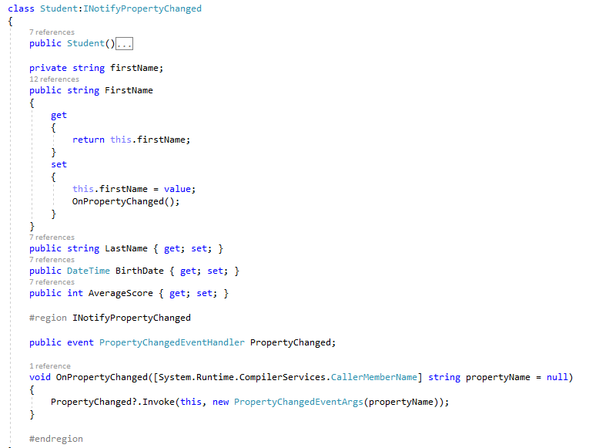
Changing the data object
Once the button is clicked we will change the data object. Note that the UI did not change the Name label! In order for the label to be changed the data object should notify the UI about every change. It can be done by implementing the interface NotifyPropertyChange
Button click event handler
INotifyPropertyChanged Interface implementation
Once a data object property is changing, the data object fires the event “PropertyChanged” that is implemented in the UI object by the Label that binds the new value to the proper label!

Slide 8

Changing the UI object
Once the button is clicked we will now change the label object. Note that the Data object did not change its FirstName property. In order for the data object to be changed the UI object should notify about the change. It can be done setting the mode of the data binding to TwoWay as follows:
Once the label text property is changing, the UI change back the data object!

Slide 9
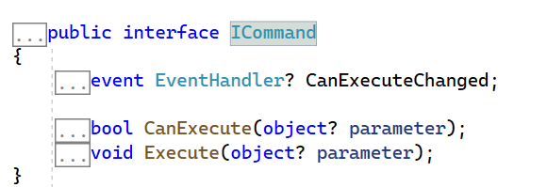
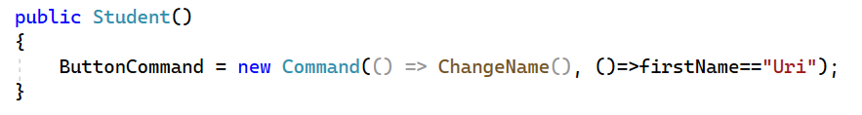
Dealing with User Interactions (Buttons and alike)
In order to deal with user interactions like clicking a button, use the Command and Command Parameter properties of a Button (and other controls).
The Command property is from type ICommand that includes the following interface:
Usually use the Command or Command<T> classes that implements Icommand amd gets an action to be executed upon button click and an action<bool> to determine if button should be enabled / disabled.

Slide 10
MVVM (Model – View Model – View)

Slide 11
What is MVVM
Model = Data
View Model = The “brain”
View = Page and Xaml
Presents the Data
Classes includes properties
Match the DTO server classes
Sometimes includes logic (like in games)
One VM class per UI Page!
Usually this class is the binding context of the Page class in the UI
Includes a property for evert piece of data in the UI Page
Includes a Command for every page interaction (like buttons)
Implement INotifyPropertyChanged interface and uses ObservableCollection to store collections

Slide 12
MVVM in an Internet App Scenario
Model = Data
View Model = The “brain”
View = Page and Xaml
Services = Web Service Proxies

Slide 13
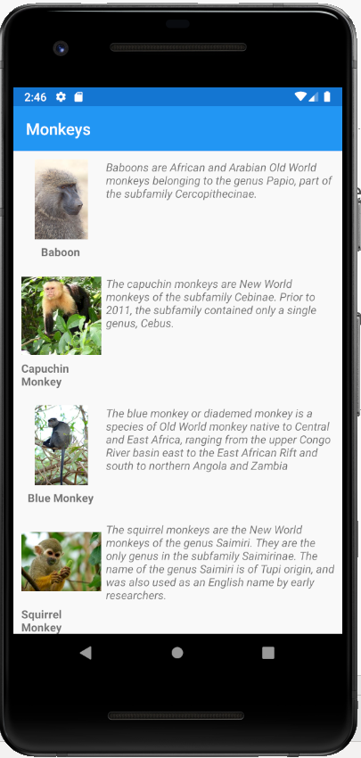
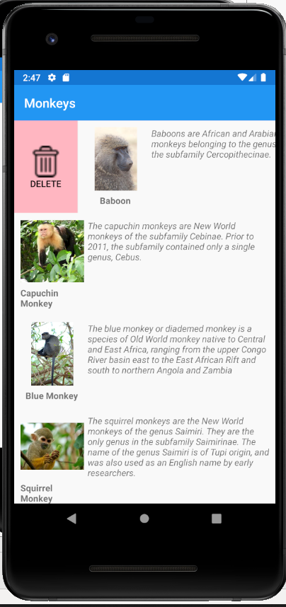
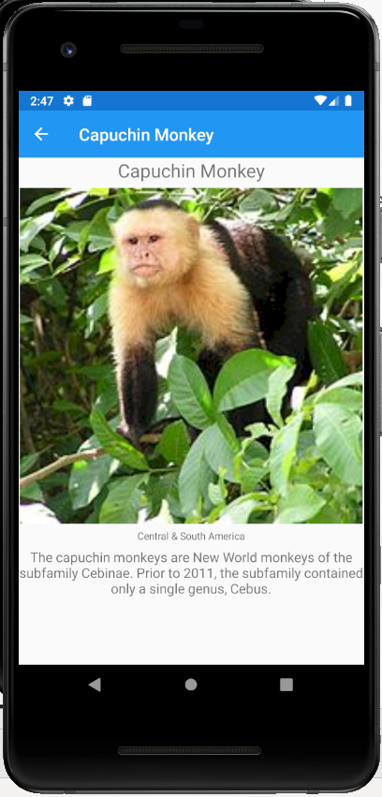
MVVM example – The Monkeys Exercise Solution
Demo – Code at https://github.com/oferzad/MonkeysExercise

Slide 14
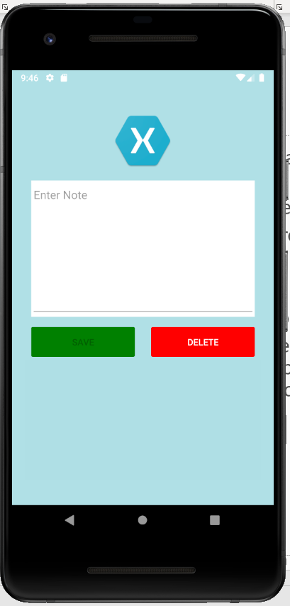
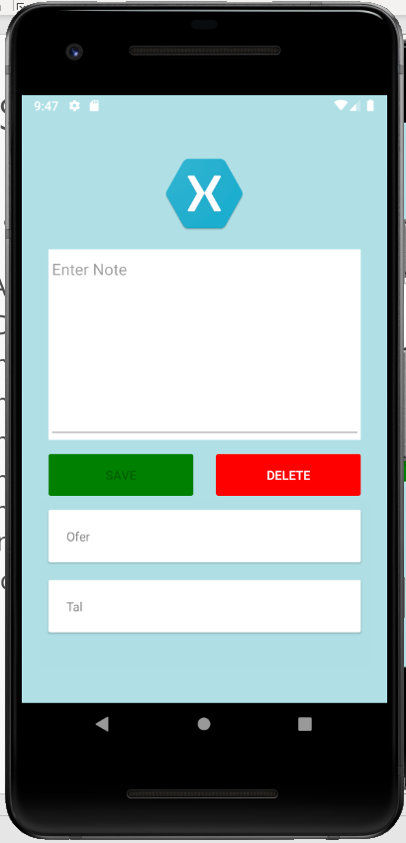
Exercise
Write an app with one page! Showing an Entry, two buttons and a collection view as shown in the picture.
The “Add” button adds the text in the entry to the collection view.
The “Delete” button deletes all items from the collection view
You should build the app using MVVM design pattern! It means that:
The Models folder will include one class to describe a note
The Views folder will include one page as described
The ViewModels folder will include one class with one property to be bound to the entry, an observable collection to be bound to the collection view and two commands: one for the Add button and second for the Delete button!
No need for a “Service” folder
The following video explain how to solve this exercise.

